Slide 1
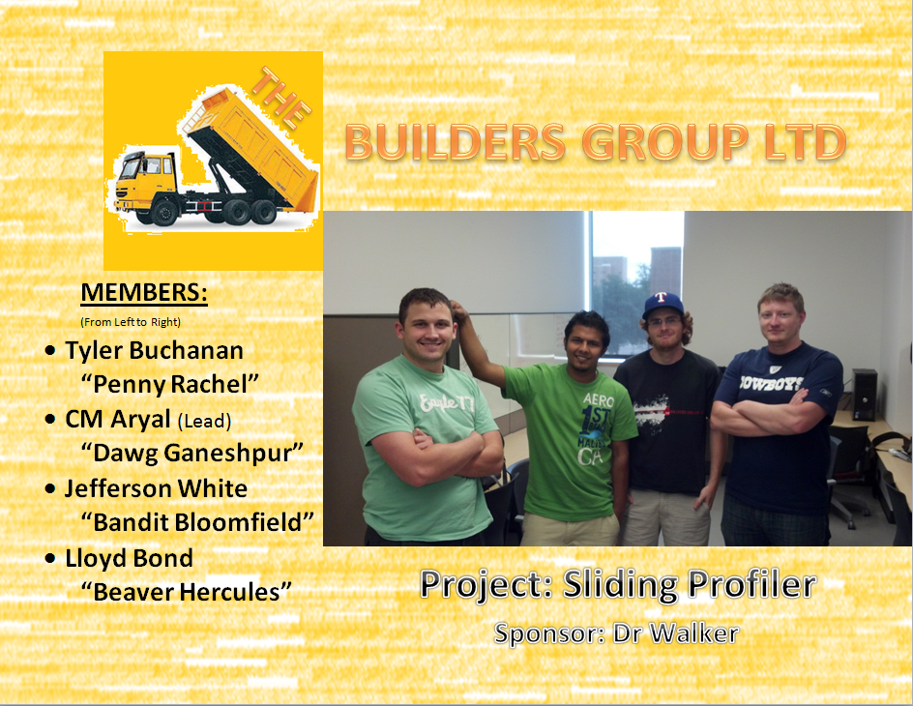

Slide 2
General Organization

Slide 3
Project Manager
Chudamani Aryal

Slide 4
Oversight of the Project
Internal Status Monitoring
External Status Monitoring

Slide 5
Internal Status Monitoring
Work Breakdown Structure
Status Reports
Immediate Task Status Reporting
Scheduled Meetings

Slide 6
External Status Monitoring
Team Status Reports
Team Status Update Presentations

Slide 7
Roles and Responsibilities
Team Members | Responsibilities
Chudamani Aryal | Project Manager, Project planner, Integration lead, Schedule
Tyler Buchanan | Change manager, Collaborator, Document Manager
Jefferson White | Presentation, Risk Manager
Lloyd Bond | Procurement Manager, Quality Manager, Meeting scribe

Slide 8
Roles and Responsibilities Contd.

Slide 9
Project Constraints & Assumptions
Constraints
Time Limit
4-perosn team
Limited Budget
Assumptions
Weather
Maintenance
Power Availability

Slide 10
Schedule & Cost Estimates
Checkpoints
Requirement Review Gate 24 July, 2012
Architectural Design Gate September, 2012
Detailed Design Gate October, 2012
Test Plan Gate November, 2012
Prototype Delivery December 2012
Cost Estimates
$ 800 Budget

Slide 11
Scope Statement

Slide 12
The goal of this project is to determine if early detection of inadequate ride or smoothness in Portland cement concrete (PCC) pavements can be determined and, if so, identify the appropriate correction device or procedures that can be applied before the concrete has hardened.
The upgrade will feature
PIC Microcontroller instead of an Embedded PC
GPS location tracking
More Friendly UI
Improved platform (floating capability, light weight, better mechanical design)
More tolerant components for extreme weather conditions applicable to laying concrete

Slide 13
Cost Management Plan

Slide 14
Labor Management
Breakdown of Schedule
Work Allocation
Team Meetings
Internal Deadlines

Slide 15
Material Management
Approval of Purchase Order
Response to Cost Variances
Use of Re-Useable Materials

Slide 16
Earned Value Management

Slide 17
Measurement
Budgeted Cost of Work Scheduled (BCWS)
Actual Cost of Work Performed (ACWP)
Budgeted Cost of Work Performed (BCWP)

Slide 18
Reporting
Cost Performance Index
CPI = BCWP/ACWP
Schedule Performance Index
SPI = BCWP/BCWS
Analysis
CPI > 1.0 = exceptional performance
CPI < 1.0 = poor performance
Similar for SPI

Slide 19
Scope Management Plan
The scope of this project will be defined by the baseline requirement specification
Any possible changes to the scope will be discussed with the team and project sponsor

Slide 20
Work Breakdown Structure

Slide 21
Phase 1
SRS
Project Charter
Team Meetings
Sponsor Meetings
R&D

Slide 22
Phase 2
ADS
DDS
Test Plan
Implementation
Team Meetings
Sponsor Meetings

Slide 23
Quality Management Plan

Slide 24
Overview
Component Testing
Integration Testing
Formal & Informal Test Plans
Access to Previous Test Results

Slide 25
Roles and Responsibilities
Role | Responsibilities | Assigned Personnel
Quality manager | Inquire about testing progress/issues of completed components Help generate formal and informal test plans Track component testing results for future reference Report any findings and keep the group apprised of known bugs and flaws Ensure product development continues to take into account the acceptance criteria Assess priority of findings and allocate resources to address as necessary | Lloyd Bond
Hardware, Software, Platform Developers | Generate informal test plans with Quality Manager’s assistance as necessary Test individual components before submission as complete Inform Quality Manager of testing generalities and any issues encountered | Team Members
Test Engineers | Follow formal test plans Perform integration testing Inform Quality Manager of results of testing and any issues encountered | Team Members

Slide 26
Communications Plan

Slide 27
Internal Communications
Meetings
Phone
Emails
GitHub

Slide 28
External Communications
Includes Sponsor and Team Supervisor
Emails
Personal Meetings

Slide 29
Change Management Plan

Slide 30
Roles and Responsibilities
Project Sponsor
Project Manager
Change Manager
Project Team

Slide 31
Review & Approval Process
Analysis of Impact
Discussion
Approval
Plan of Action

Slide 32
Risk Management Plan

Slide 33
Roles and Responsibilities
Project Sponsor
Project Manager
Risk Manager
Project Team

Slide 34
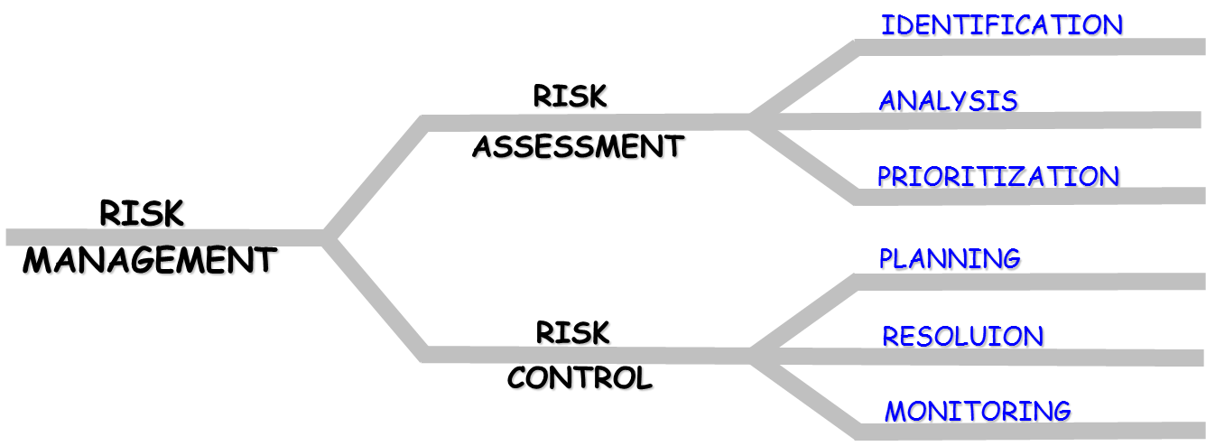
Risk Management Steps
Source: Mr. Mike O’Dell

Slide 35
Procurement Management Plan

Slide 36
Roles and Responsibilities
Role | Responsibilities | Assigned Personnel
Project Sponsor | Make purchasing approvals | Roger Walker
Team Supervisor | Make purchasing approvals | Michael O’Dell
Procurement Manager | Work with Lead Architect to identify project procurement needs Perform procurement cost analysis Obtain procurement approval Track purchase orders Report completed purchases | Lloyd Bond
Integration Lead | Work with Procurement Manager, Hardware Architect, Software Architect, Platform Architect to identify purchasing needs | Chudamani Aryal
Team Members | Perform procurement identification as necessary according to role | Chudamani Aryal, Tyler Buchanan, Jefferson White, Lloyd Bond

Slide 37
Project Closeout Report

Slide 38
Administrative Closure
Objectives Met
Archiving Project Artifacts
Lessons Learned Sessions
Post Review
Final Customer Acceptance
Final Project Performance Report

